Slide 1

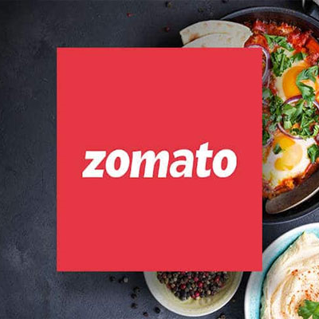
Zomato Data Analysis
KARMUKILAN D K

Slide 2
CONTENTS
ABOUT DATASET
ANALYSIS USING SQL
PREPROCESSING
DASHBOARD
INSIGHTS
CONCLUSION

Slide 3
ABOUT DATASET
Number of Columns : 21
Number of Rows : 9551

Slide 4
PREPROCESSING
Data Cleaning:
Removed duplicate rows based on Restaurant_ID.
Replaced NULL values in the 'City' column with 'Unknown’.
Trimmed leading and trailing spaces from string columns.
Data Quality Checks:
Identified rows with NULL values in non-nullable columns.
Checked for invalid values in numeric columns.

Slide 5
PREPROCESSING
Data Modelling:
Create tables for Restaurants, Locations, Cuisines, and Ratings.
Data Insertion:
Inserted distinct restaurant data into the Restaurants table.
Inserted location data into the Locations table.
Inserted cuisine data into the Cuisines table.
Inserted rating data into the Ratings table.

Slide 6
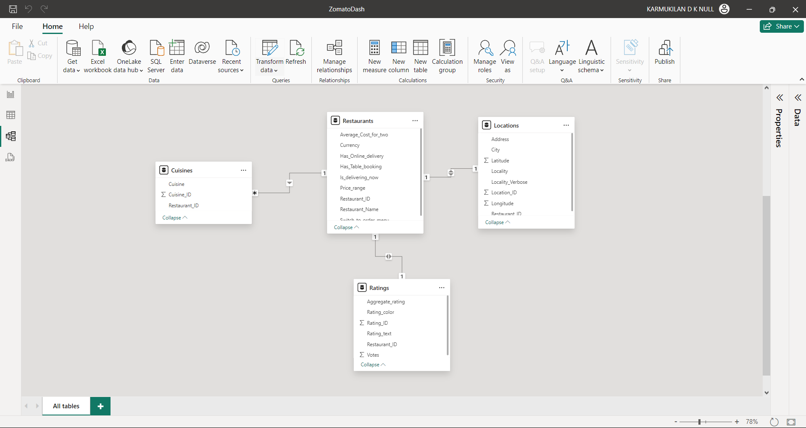
DATA MODELLING
STAR SCHEMA

Slide 7


Slide 8
Total Restaurants: 7,433 Total Cities: 141 Total Countries: 12
General Overview

Slide 9
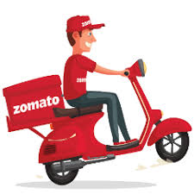
Online Delivery Analysis
Cities without Online Delivery: 140 (86.42%)
Cities with Online Delivery: 22 (13.58%)

Slide 10
Table Booking Analysis
Cities without Table Booking: 137 (83.03%)
Cities with Table Booking: 28 (16.97%)

Slide 11
Cuisine Diversity Analysis Top Cities with Cuisine Variety:
New Delhi: 10.89K cuisines (55.24%)
Gurgaon: 2.39K cuisines (12.14%)
Other notable cities include Noida, Faridabad, Ahmedabad, Jaipur, Mumbai, and Pretoria with varying counts of cuisines.

Slide 12
High Average Cost for Two in Jhatakra City
Economic Factors:
Higher average income levels
Higher living costs
Restaurant Types:
Predominance of upscale, fine dining establishments
Higher operating costs for premium services

Slide 13
KEY INSIGHTS
Online Delivery is not very widespread, with only a small percentage of cities offering this service.
Table Booking services are more common than online delivery but still not available in the majority of cities.
The vast majority of cities do not offer delivery now services.
New Delhi and Gurgaon are significant contributors to the cuisine variety and ratings, indicating a high concentration of diverse and highly rated restaurants.
The average cost for two varies widely across different cities, indicating a broad range of economic conditions and dining standards.
Cuisine popularity and ratings show a diverse taste preference among customers, with many different cuisines being offered and rated.

Slide 14
RECOMMENDATIONS
Expand Online Delivery Services
Enhance Table Booking Facilities
Improve Immediate Delivery Options
Promote Culinary Diversity
Optimize Pricing Strategies
Continuously Monitoring and responses

Slide 15
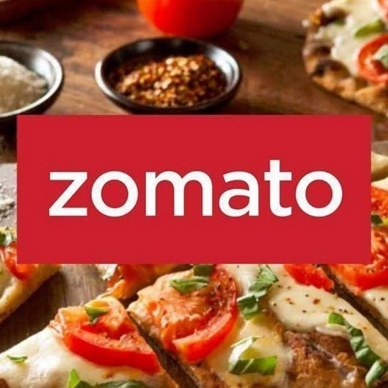
Thank You!

